Slide 1
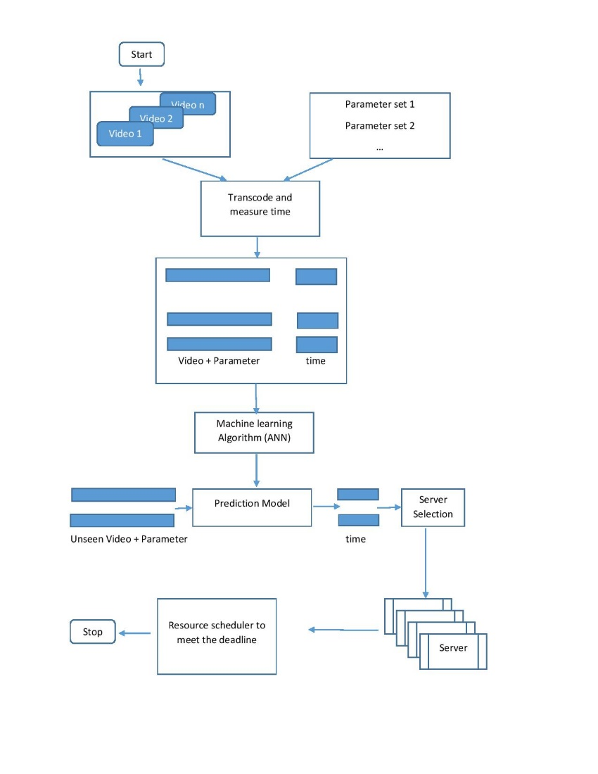
VIDEO TRANSCODING TIME PREDICTION
INTRODUCTION
BACKGROUND
Control flow diagram
Today, computing systems vary significantly from one another and range from very small (example: cell phones, tablets) to very large (servers, data centres, cloud). Video content is being produced and consumed in more manners and devices than ever, therefore a seamless interaction is required between video content transporting, producing and consuming devices.
The difference in device resources, network bandwidth and video representation types results in the necessary requirements for a mechanism for video content adoption. One such mechanism is called video transcoding. Video transcoding refers to the process of converting one compressed video representation to another.
Transcoding is a computationally complex and heavy process. If transcoding time of a video is known beforehand, transcoding task can be scheduled efficiently.
The main objective of the project is to design an automated system that predicts the transcoding time of videos.
Due to the correlation between transcoding time and video parameters, we can predict transcoding time of a video given the input video and the transcoding parameters which in turn is used to properly schedule the video transcoding requests across servers.
To predict the transcoding time of a video, we use one of the most widely used supervised machine learning algorithms, the Artificial neural network (ANN).
Allocation strategies
Conclusion
Our project has successfully covered all the aspects of transcoding time prediction. After transcoding time is predicted transcoding task is scheduled properly so that none of the tasks misses their deadline.

